Slide 1
Applying Weak Supervision to Reduce Knowledge Obsolescence
Dongjae Lee Spencer Starks
Notes:
Do this slide though

Slide 2
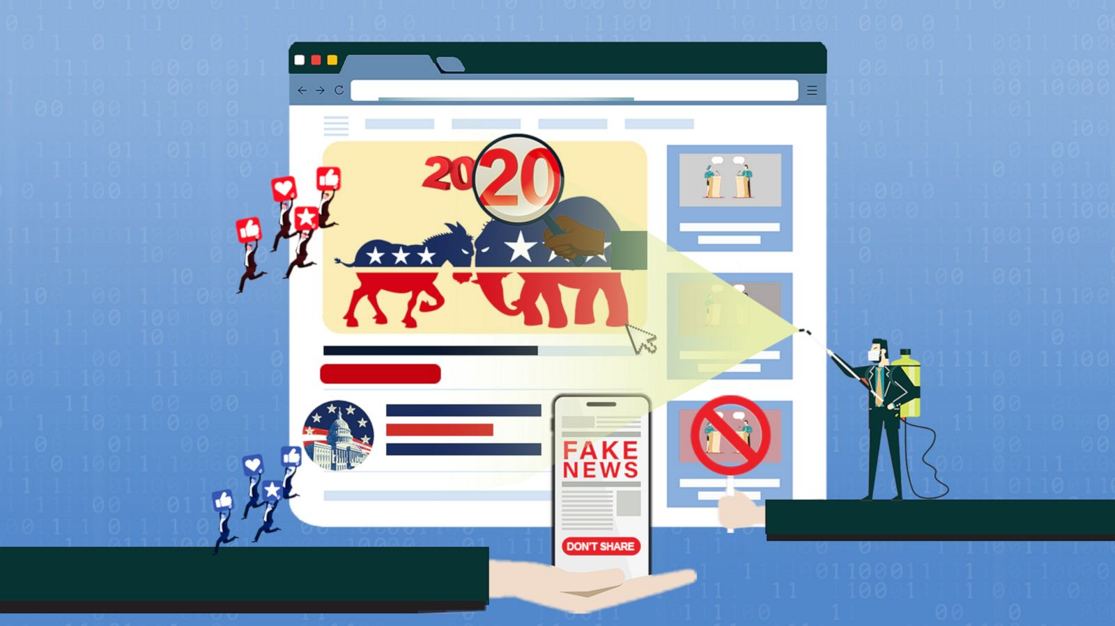
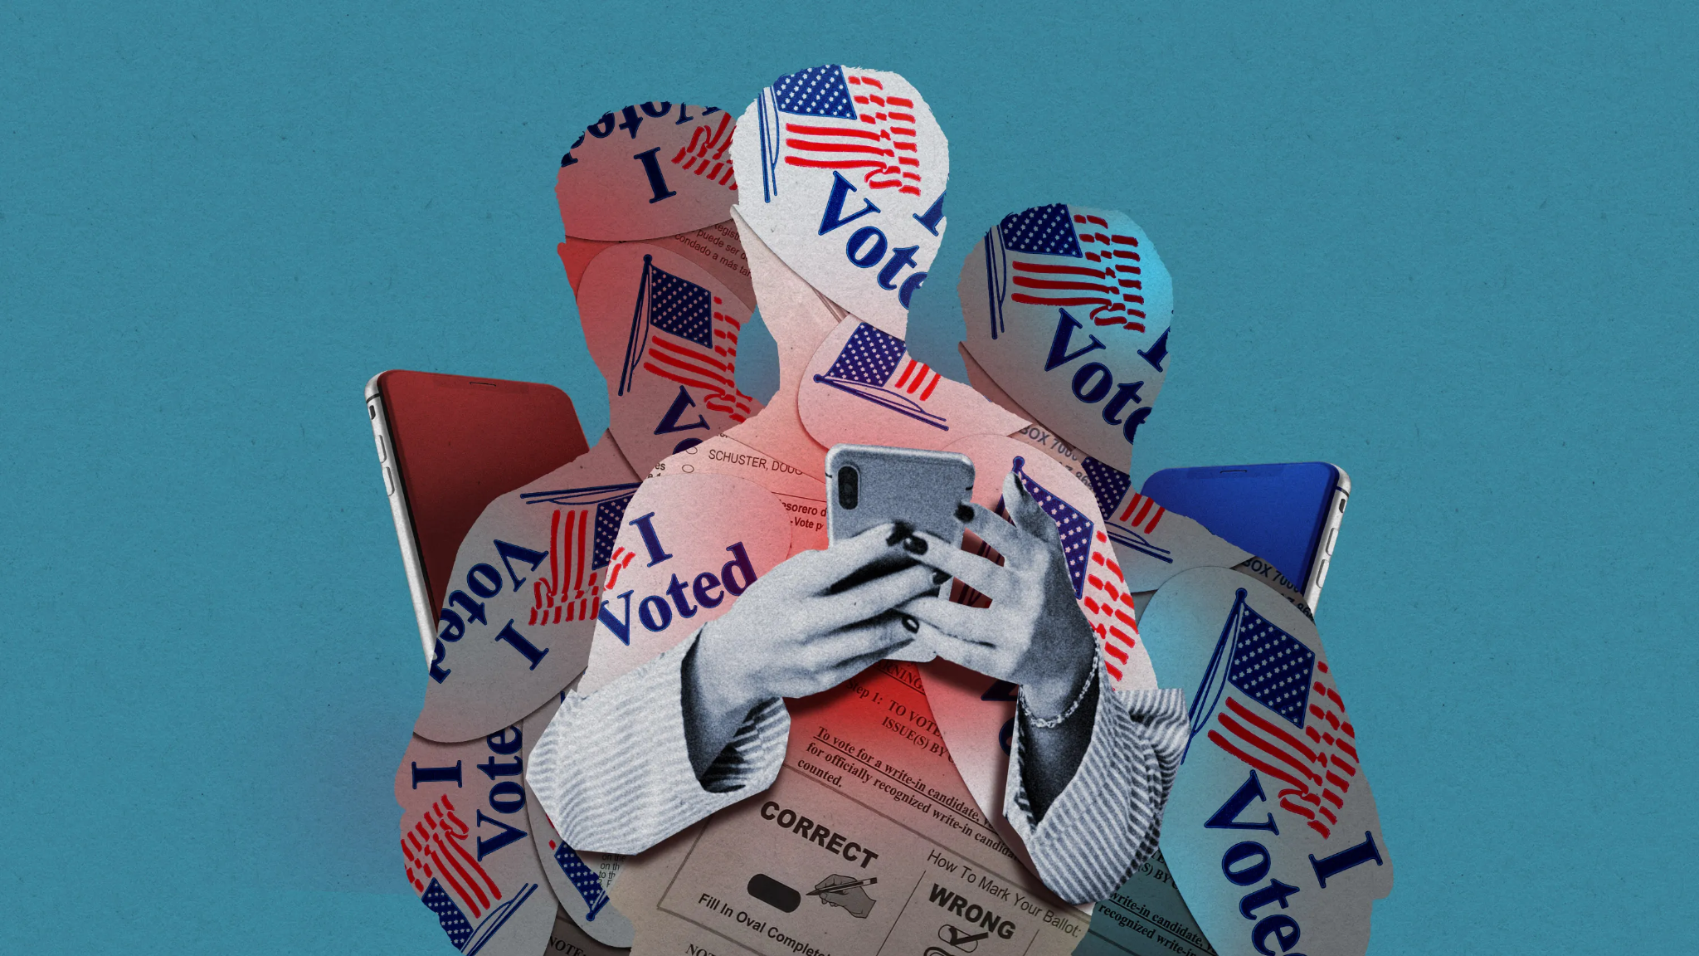
Motivation
Limit the spread of misinformation
Use weak supervision to speed up process of annotating data
Project has real world implications
Upcoming elections
Rise of misinformation in social media

Slide 3
Related Work
The paper by Farchi et al. does similar work in modeling chaotic systems where they implemented machine learning models into their data assimilation step to account for changes in their predictions
The research paper by Ratner et al. introduces the application of Snorkel to create weak supervised learning models that is faster and more accurate than their traditional counterparts
Real world applications of Snorkel framework for different industries
Implementation of Snorkel in the tech industry such as Microsoft Azure

Slide 4
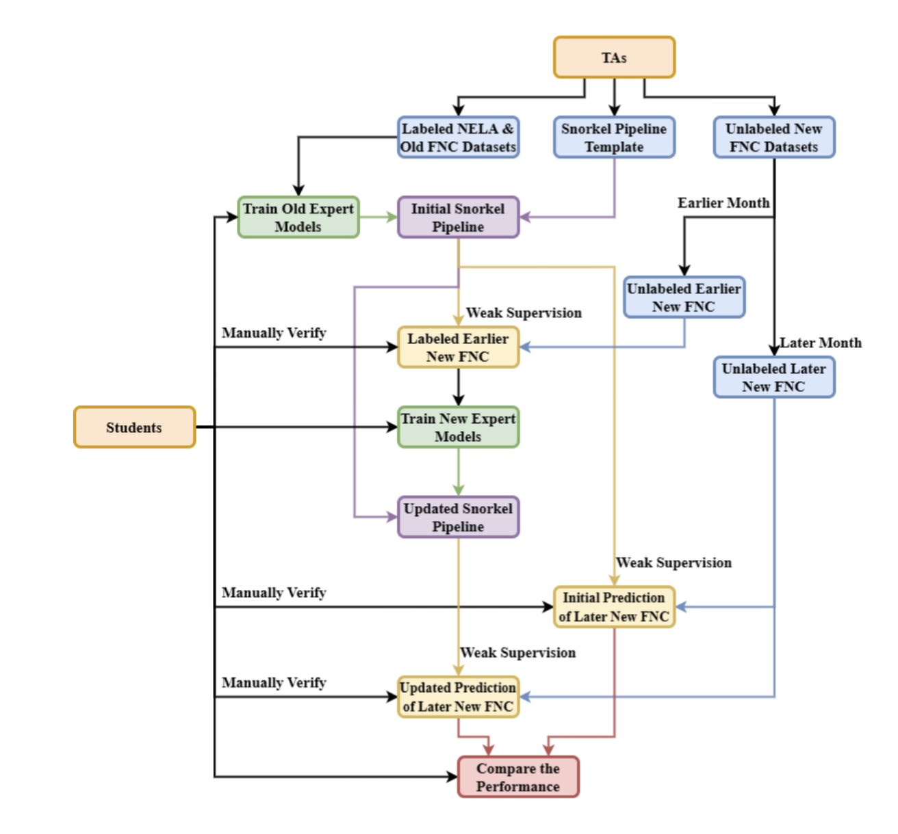
Proposed Approach and Methodology
Follow underlying training methodology and workflow
Training models using labeled data
Labeling unlabeled data using weak supervision
Update model to account for knowledge obsolescence
Compare the updated model with original model
Notes:
Spencer

Slide 5
Achievements Over Past 8 Weeks
Weeks | Tasks Completed
1-2 | Annotated New FNC Dataset, manually labeling over 1,100+ entries as either factual information or fake news regarding COVID-19
3-4 | Trained multiple different models based on NELA and Old FNC and tested these models against our manually labeled New FNC datasets
5-6 | Produced graphing software to visualize and model results from the previous two weeks and began researching Snorkel models
7-8 | Use Snorkel to assemble NELA and old FNC models to train new FNC models on different datasets to produce meaningful statistics

Slide 6
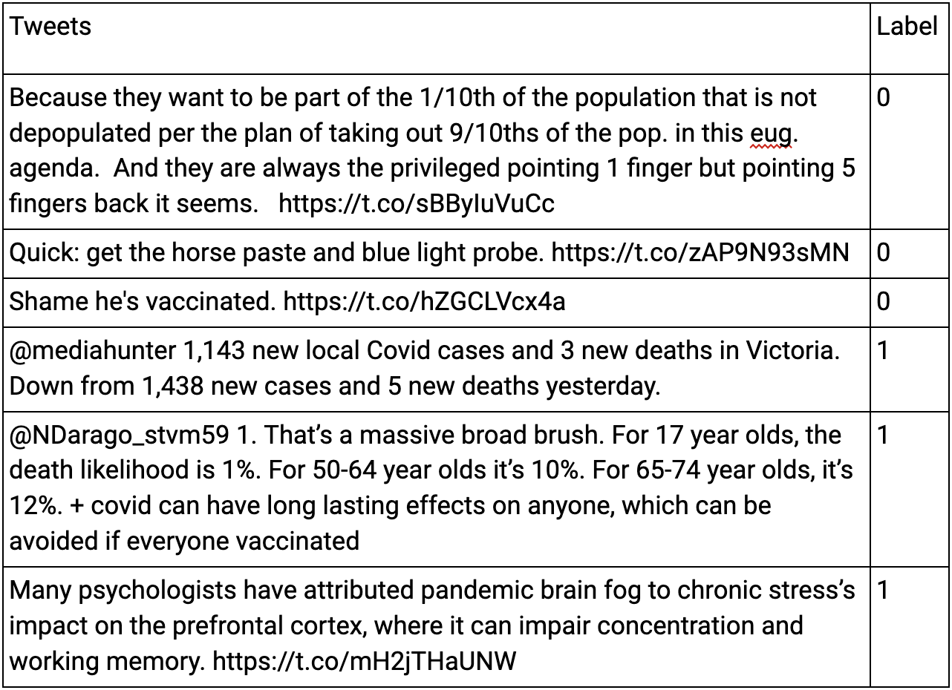
Implementation and Methodology
Labeling Data:
Label FNC Dataset
Subsampled Tweets each month relating to COVID-19
Converted large JSON file to smaller CSV file containing tweet message and label
0 - Misinformation
1- Truth

Slide 7
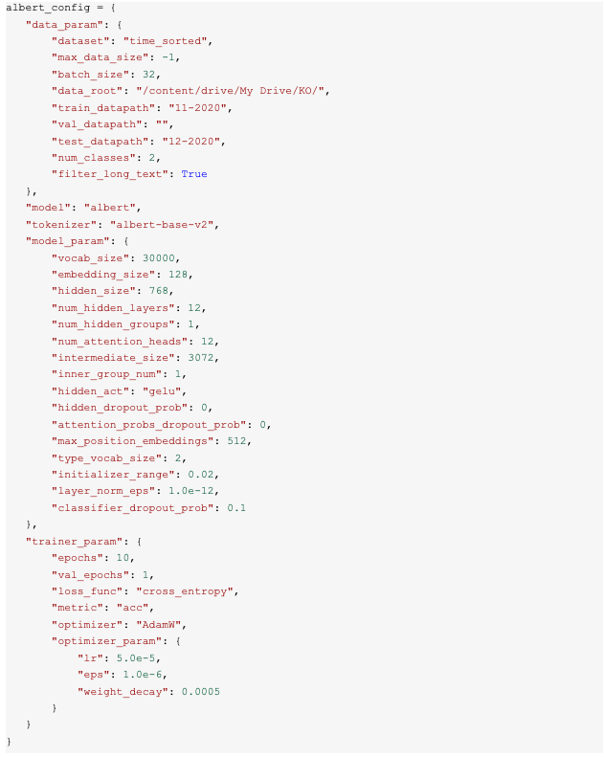
Implementation and Methodology
Model Configuration and Training
Trained 2 different models with Old FNC and tested with labeled data for initial Snorkel Model
Albert
Bert
Adjusted hyperparameters of each model

Slide 8
Challenges with ALBERT
ALBERT Model | Old FNC 4-2021 | Old FNC 5-2021
Training Accuracy | 70.3% | 75.7%
New FNC 10-2021 Testing Accuracy | 49.1% | 48.1%
New FNC 11-2021 Testing Accuracy | 56.8% | 57.5%
We made a troubling discovery with
ALBERT during our initial training
ALBERT Model | NELA 11-2020 | NELA 12-2020
Training Accuracy | 97.3% | 65.6%
New FNC 10-2021 Testing Accuracy | 47.5% | 47.1%
New FNC 11-2021 Testing Accuracy | 57.2% | 57.5%

Slide 9
Implementation and Methodology
Development of new models
GPT and GPT2 models were adapted and developed
More advanced models than original
Labeling functions would be integrated with the original Snorkel pipeline

Slide 10
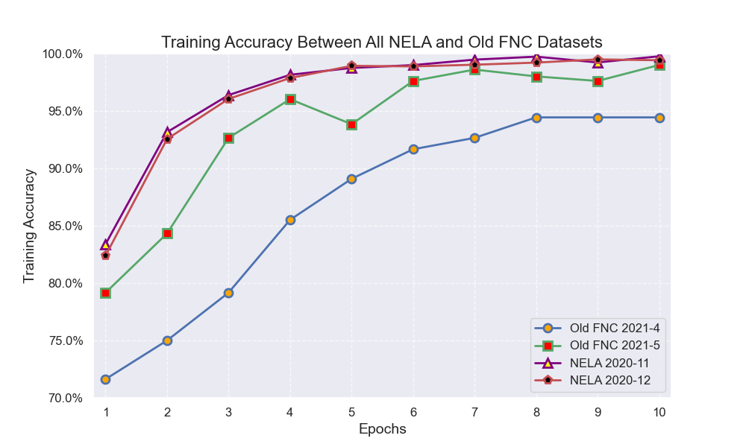
Results and Relevant Charts

Slide 11
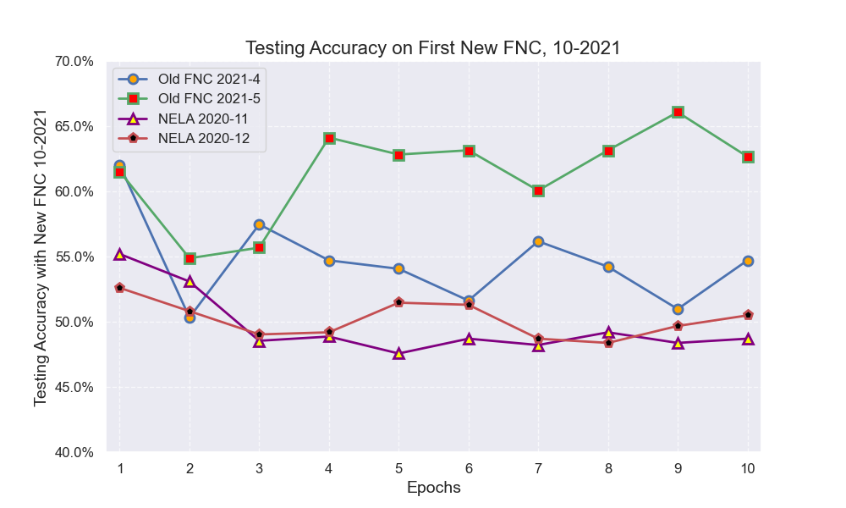
Results and Relevant Charts

Slide 12
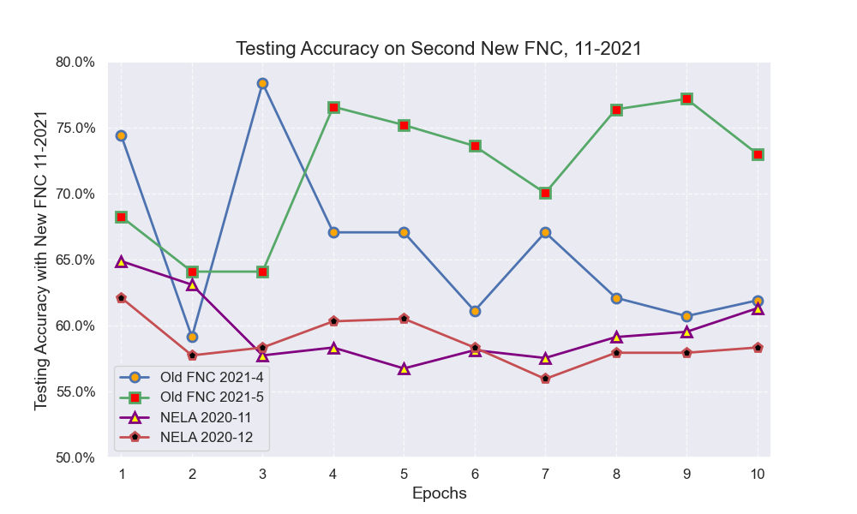
Results and Relevant Charts

Slide 13
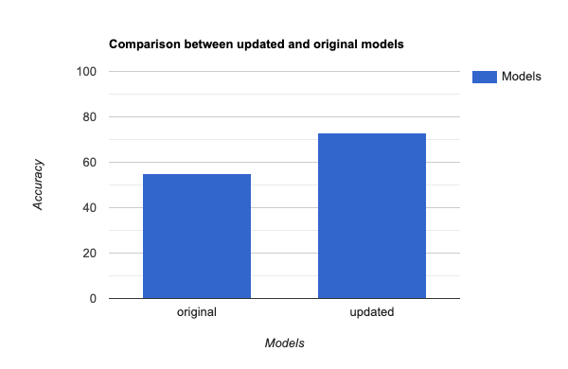
Comparison between updated and original mode
Updated Model Accuracy:
The snorkel pipeline updated model achieved an accuracy of 73%.
Baseline Model Accuracy: This was an improvement on the BERT model which had an average of around 55%.
Improved Percentage:
This was a 32.7273% increase which was a significant improvement over the original model.

Slide 14
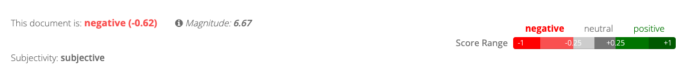
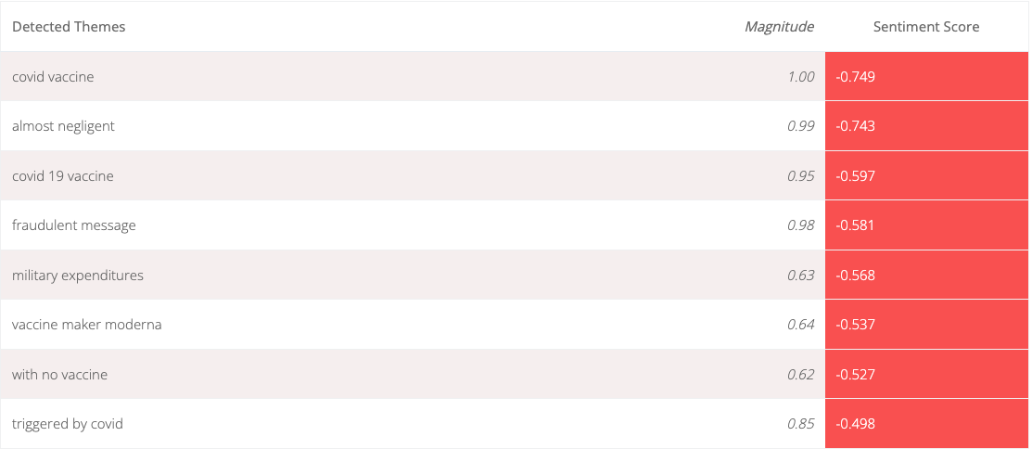
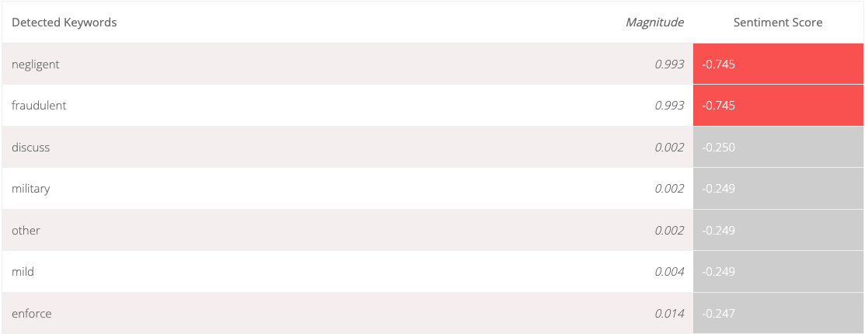
Additional Graphics
Tweet sentiment analysis
Additional research on text of tweets labeled as misinformation
Misinformational tweets generally more negative

Slide 15
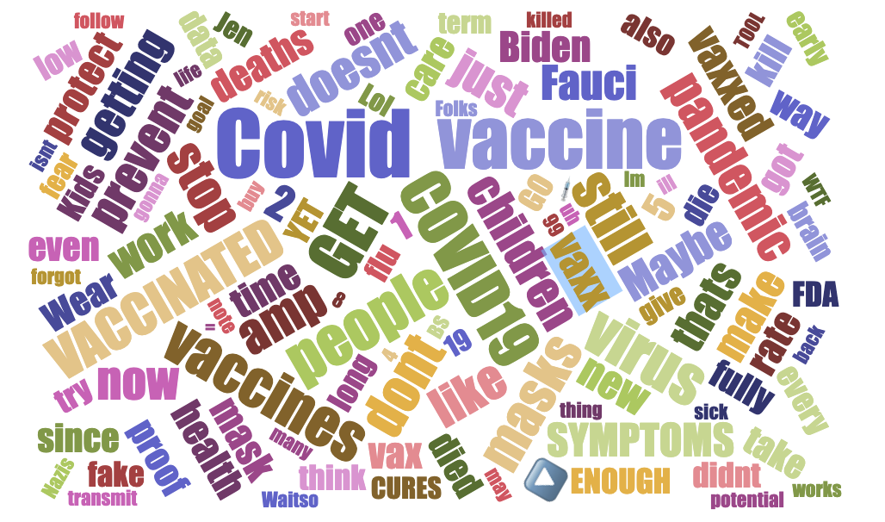
Additional Graphics
Keywords Word Cloud
Terms are generally more colloquial
Words such as "kill" and "Nazis" are emotionally charged and extreme

Slide 16
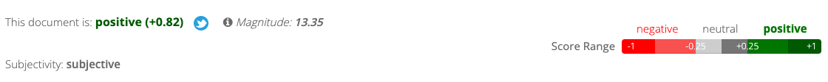
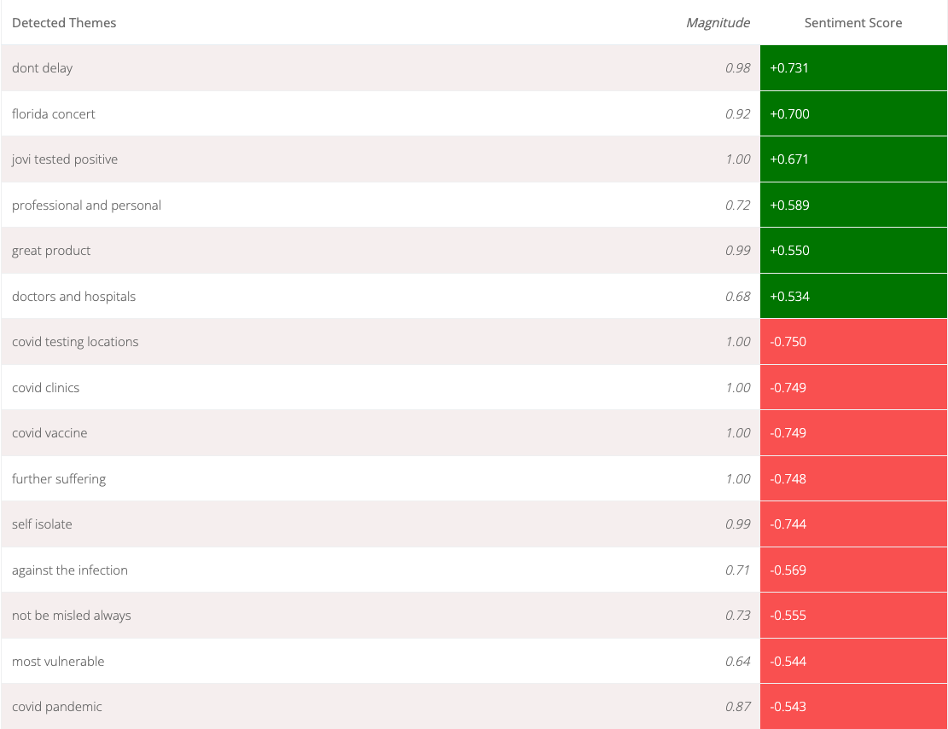
Additional Graphics
Tweet sentiment analysis
Informational tweets generally more positive
Our hypothesis is due to informational tweets having more statistics

Slide 17
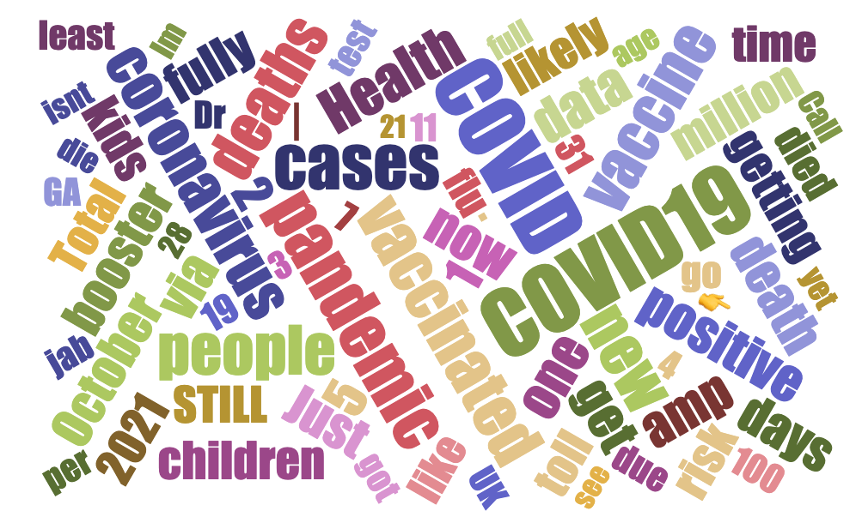
Additional Graphics
Keywords Word Cloud
Numbers are generally more prevalent
Proper nomenclature is used more commonly

Slide 18

Skills Learning
Throughout the project we have learned and honed many different skills of all levels

Slide 19

Level 1 Skills Learned
Differentiating Facts vs. Opinions
Applying New Programming Techniques

Slide 20

Level 2 Skills Learned
Applying Theory to Practice
Learning and Integrating new Platforms
Implement new Functionality by Augmentation

Slide 21
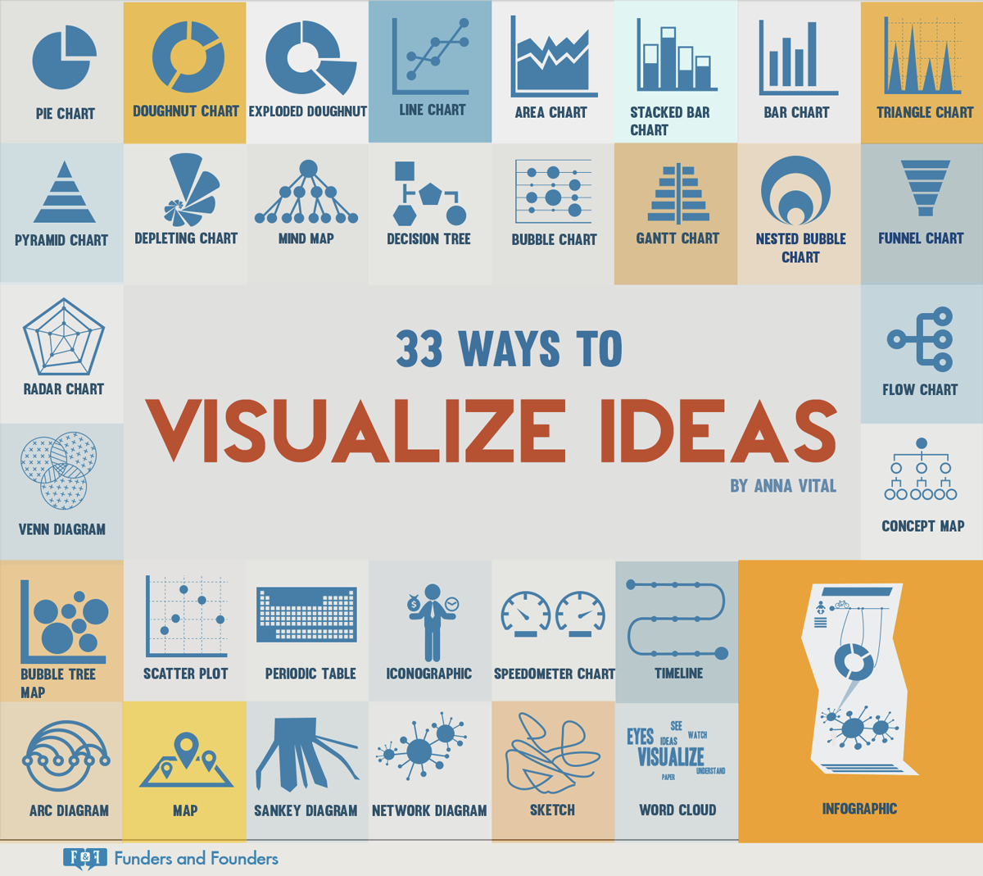
Level 3 Skills Learned
Trend and Distribution Recognition
Distribution Visualization

Slide 22
Future Work
Improved Datasets: Future research should use datasets heavily related to COVID-19 and expand labeled data beyond the current 500 entries to enhance model training and reduce overfitting.
Diverse Models and Frameworks: Incorporating diverse models and new frameworks like LLaMA could improve labeling quality and testing accuracy.
Enhanced Accuracy and Generalization: These improvements would lead to higher accuracies and more effective weak supervision models, facilitating significant advancements in reducing COVID-19 misinformation on social media.

Slide 23
References
Aimpoint Digital Partners With Snorkel AI to Accelerate AI Development: The partnership between noted analytics firm Aimpoint Digital and data-centric AI innovator Snorkel AI aims to accelerate the adoption of machine learning for Fortune 500 enterprises. (2022). In NASDAQ OMX’s News Release Distribution Channel. NASDAQ OMX Corporate Solutions, Inc.
Bach, S. H., Rodriguez, D., Liu, Y., Luo, C., Shao, H., Xia, C., Sen, S., Ratner, A., Hancock, B., Alborzi, H., Kuchhal, R., Ré, C., & Malkin, R. (2019). Snorkel DryBell: A Case Study in Deploying Weak Supervision at Industrial Scale. Proceedings of the 2019 International Conference on Management of Data, 362–375. https://doi.org/10.1145/3299869.3314036
Barthel, M. (2016, December 15). Many Americans believe fake news is sowing confusion. Pew Research Center. https://www.pewresearch.org/journalism/2016/12/15/many-americans-believe-fake-news-is-sowing-confusion/
Bolla, B. K., Pattnaik, S. R., & Patra, S. (2024). Detection of Objectionable Song Lyrics Using Weakly Supervised Learning and Natural Language Processing Techniques. Procedia Computer Science, 235, 1929–1942. https://doi.org/10.1016/j.procs.2024.04.183
Davies, J. (n.d.). Word Cloud Generator. Word cloud generator. https://www.jasondavies.com/wordcloud/
Farchi, A., Laloyaux, P., Bonavita, M., & Bocquet, M. (2021). Using Machine Learning to Correct Model Error in Data Assimilation and Forecast Applications. https://doi.org/10.5194/egusphere-egu21-4007
Gupta, D. (2020). Alumni launch Snorkel, rethink machine learning. In University Wire. Uloop, Inc.
Mallory, E. K., de Rochemonteix, M., Ratner, A., Acharya, A., Re, C., Bright, R. A., & Altman, R. B. (2020). Extracting chemical reactions from text using Snorkel. BMC Bioinformatics, 21(1), 217–217. https://doi.org/10.1186/s12859-020-03542-1
Ratner, A., Bach, S. H., Ehrenberg, H., Fries, J., Wu, S., & Ré, C. (2017). Snorkel: Rapid Training Data Creation with Weak Supervision. Proceedings of the VLDB Endowment, 11(3), 269–282. https://doi.org/10.14778/3157794.3157797
Ratner, A., Bach, S. H., Ehrenberg, H., Fries, J., Wu, S., & Ré, C. (2020). Snorkel: rapid training data creation with weak supervision. The VLDB Journal, 29(2–3), 709–730. https://doi.org/10.1007/s00778-019-00552-1
Ratner, A., Hancock, B., Dunnmon, J., Goldman, R., & Ré, C. (2018). Snorkel MeTaL: Weak Supervision for Multi-Task Learning. Proceedings of the Second Workshop on Data Management for End-To-End Machine Learning, 2018, 1–4. https://doi.org/10.1145/3209889.3209898
Ré, C. (2018). Software 2.0 and Snorkel: Beyond Hand-Labeled Data. Proceedings of the 24th ACM SIGKDD International Conference on Knowledge Discovery & Data Mining, 2876–2876. https://doi.org/10.1145/3219819.3219937
Sentiment analysis report. Sentiment Analysis - Free Online Demo. (n.d.). https://text2data.com/Demo?lnk=214207258
Snorkel AI Teams with Microsoft. (2023). In Wireless News. Close-Up Media, Inc.

